Slide 1
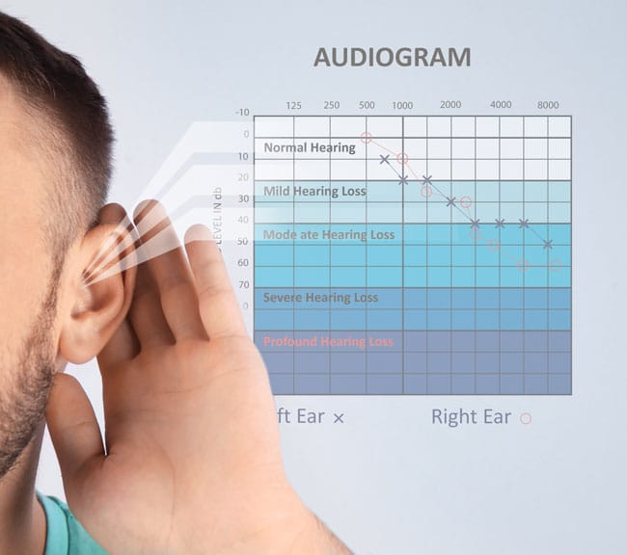
Lab #3
Matlab Audiometer
By Socheath Sok

Slide 2
Overview
Anatomy of the Ear
Importance of Audiometry
Audiometer
Procedure
Audiogram
Limitations & Improvements

Slide 3
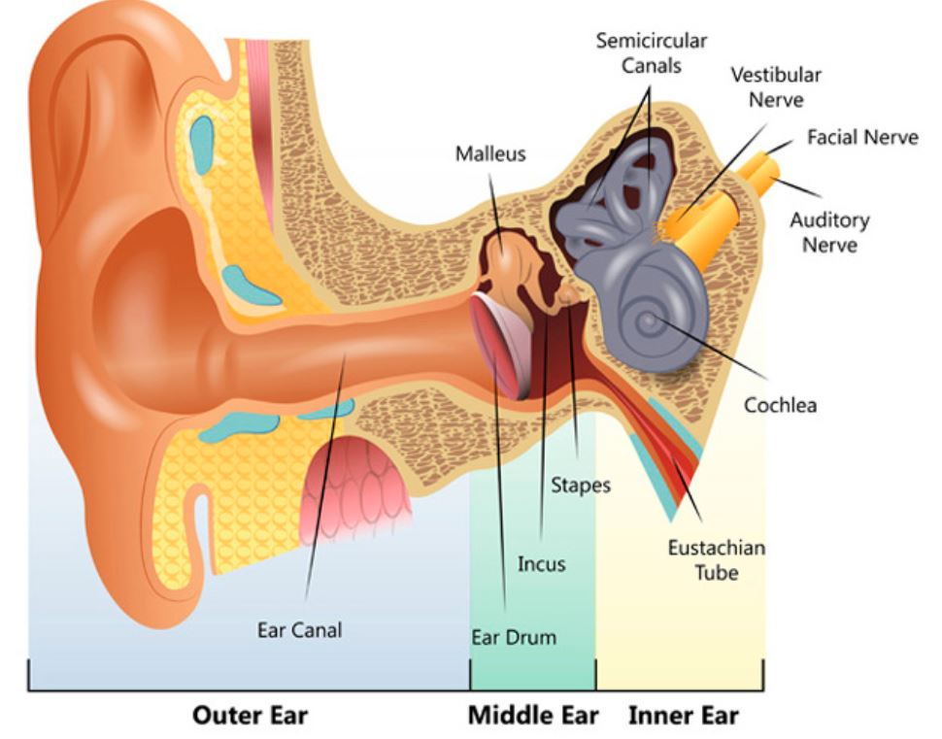
Anatomy of Ear
Peripheral hearing system :
outer ear, middle ear, and inner ear
Central hearing system :
auditory nerve and pathway to auditory cortex
Sense of Hearing:
Sound wave travel into the ear canal toward the eardrum
Eardrum vibration move the chain of tiny bones in the middle ear
transfer sound to the inner ear
Hair cells detect sound, generate nerve impulses and send it to the auditory cortex
[1]
Notes:
Sound waves,: vibrations in the air around us
eardrum is so sensitive to sound vibrations in the ear canal that it can detect even the faintest sound as well as replicating even the most complex of sound vibration patterns.
the ‘hair cells’ in the cochlea are tuned to respond to different sounds based on their pitch or frequency of sounds.

Slide 4
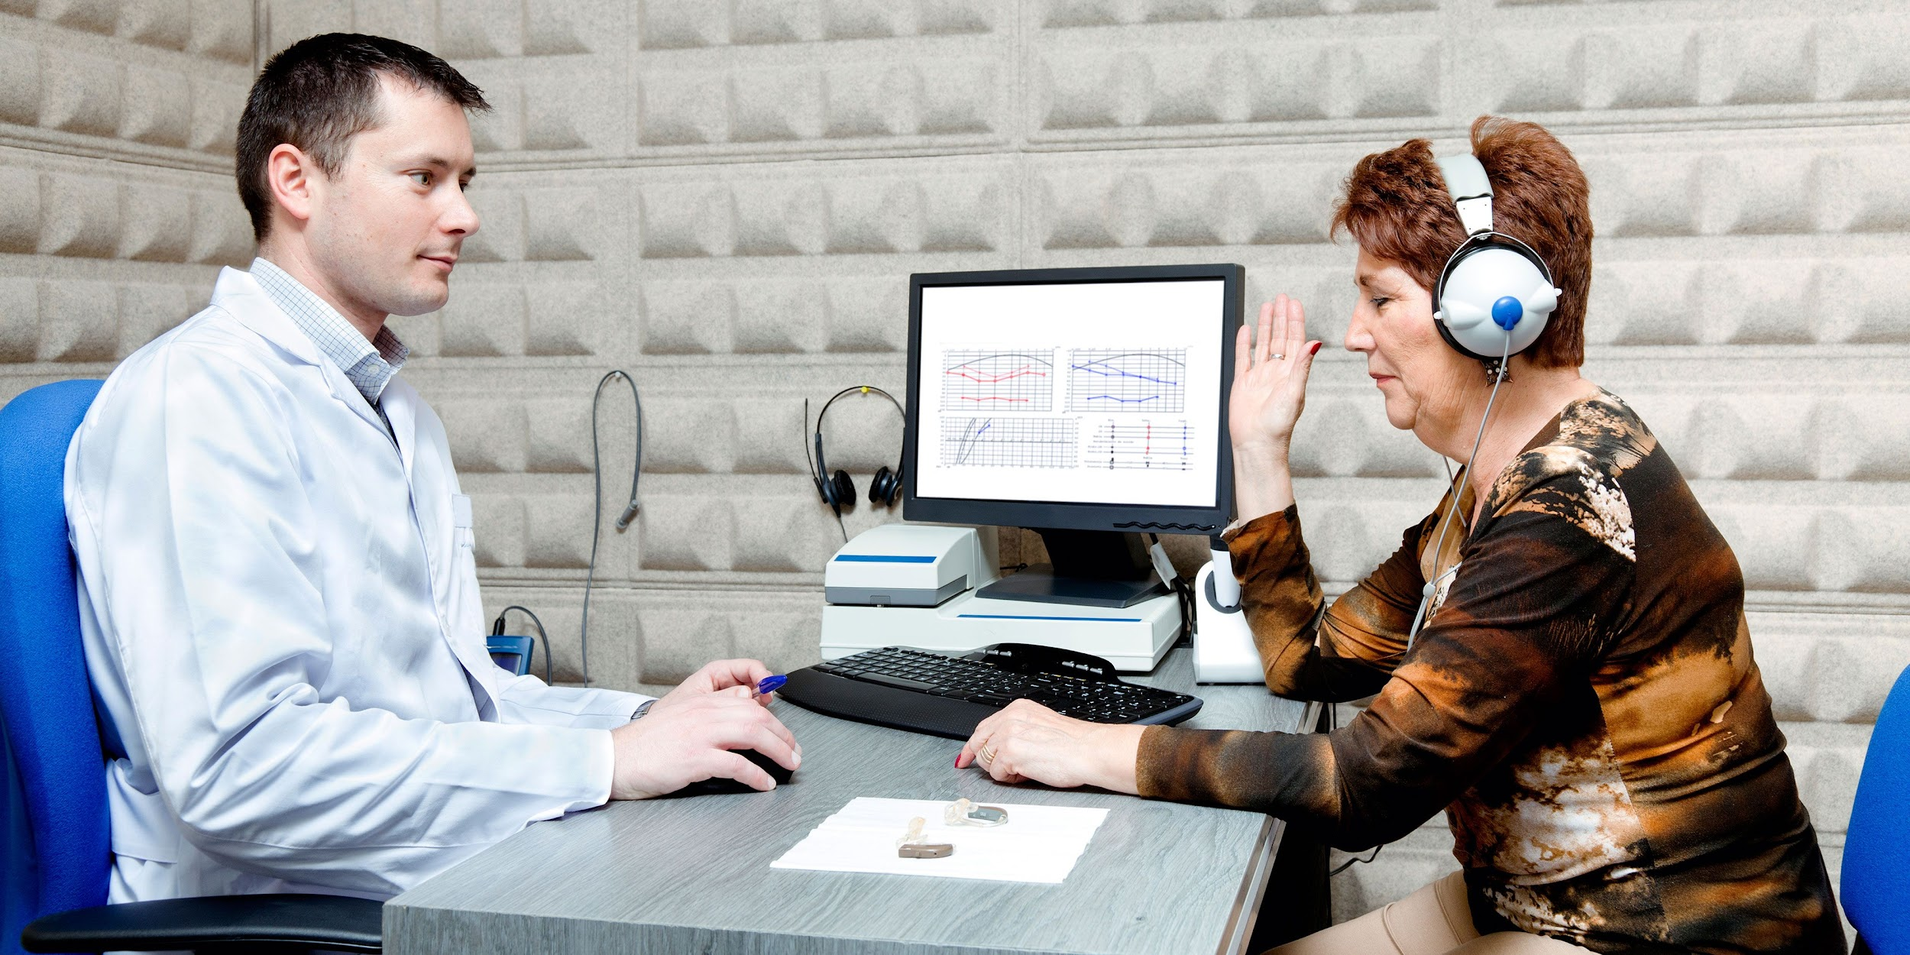
Audiometry
Branch of audiology and the science of measuring hearing acuity
test: identify the issues related to the function of the ear
Types of Hearing Loss:
Conductive: inefficient transfer of sound
Ex: blockage of wax in the ear canal
Sensorineural: Problem with inner ear or auditory nerve or pathway
Ex: damage to hair cells
[1]
Notes:
problem in the outer or middle ear, means inefficient transfer of sound to the inner ear → affect volume of sound
Sound unable to process properly

Slide 5
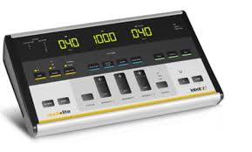
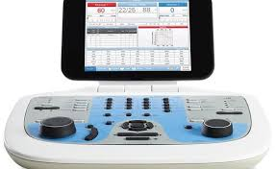
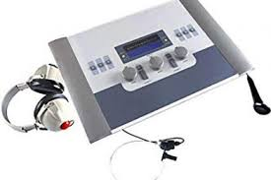
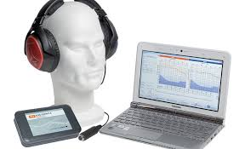
Audiometer
Price: between $800 and $5000.
Determine the ability to hear sounds
tests the intensity and the tone of sounds
Hearing range: 20 Hz to 20 kHz
more sensitive to sounds between 1 kHz and 4 kHz
The loudness of sound is measured in decibels (dB)
Usually consist of an embedded hardware unit
connected to a pair of headphones
a test subject feedback button
[2] & [3]

Slide 6
Procedure
Introduction
Volume Adjustment
Hearing Test
Name
Age
Gender
Display a sound
Ask user to adjust the volume until the sound is acceptable
Play 10 sounds
f range: 250 to 10000 Hz
A range: 0 to 10
Both f and A are generated randomly
Notes:
user will interact with the software by reading the instruction and answer the questions that pop up thru out the test.

Slide 7
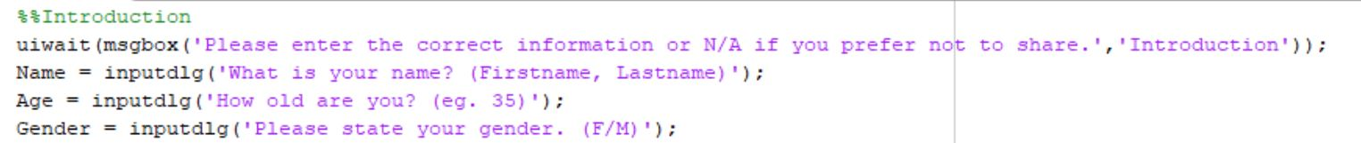
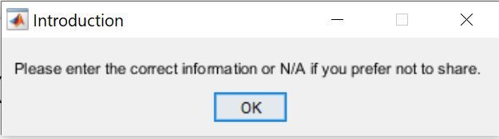
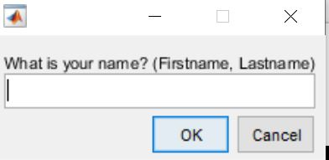
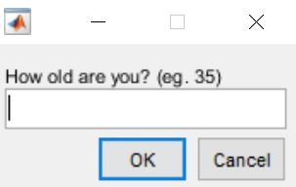
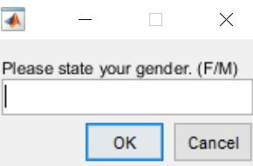
Introduction

Slide 8
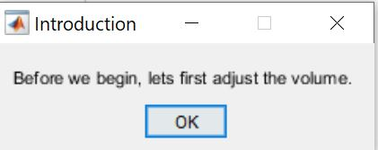
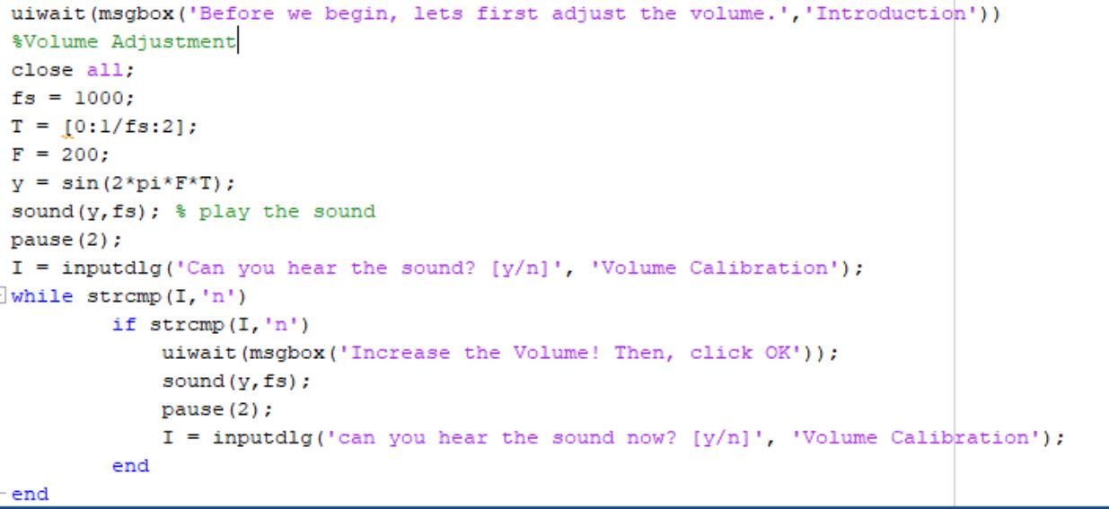
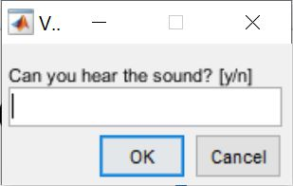
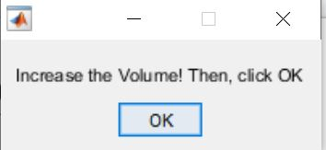
Volume Adjustment

Slide 9
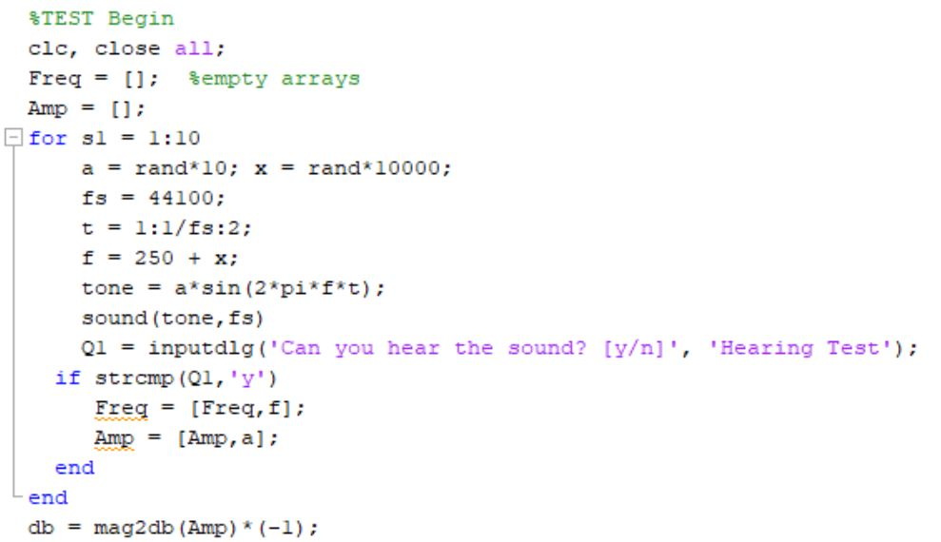
Test Setup
Sampling Frequency
Sampling Time
Amplitude
Test Frequency
Sine Wave Tone

Slide 10
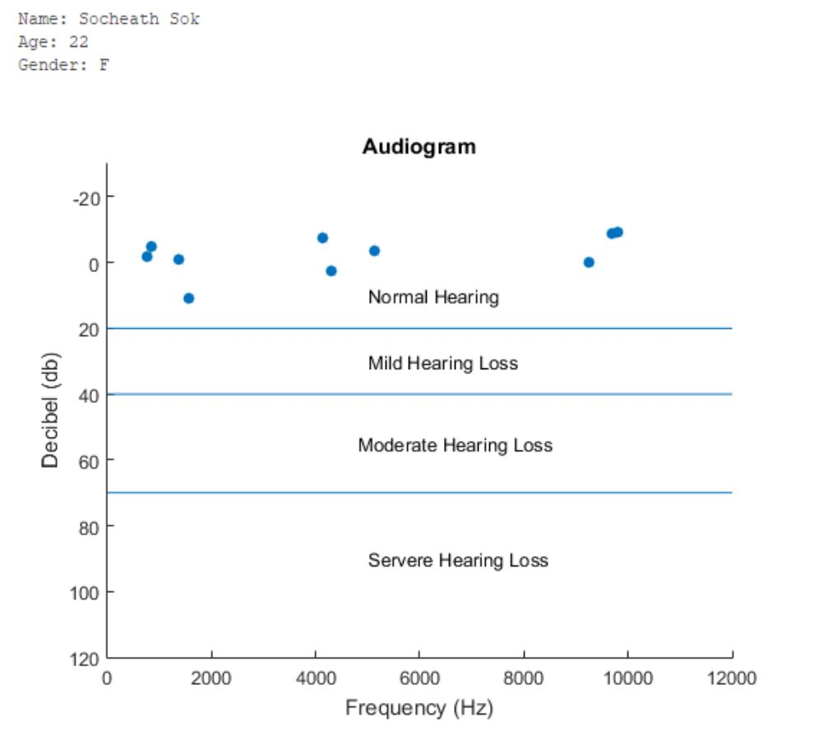
Result

Slide 11
Limitations & Future Improvements
No calibration method
Limited frequency range
Poor sound quality at high frequency
Low accuracy
Non-ideal environment
Not very useful data
Use hardware to increase the frequency range
Ex: piezo speaker
Add sound level calibration
Improve software usability by using MATLAB GUI
Conduct the test in more ideal environment
acoustic lab
noise cancelling headphone
Increase the sample size

Slide 12
References
[1] “Understanding How the Ear Works.” Hearing Link,
https://www.hearinglink.org/your-hearing/about-hearing/how-the-ear-works/.
[2] “How to Read an Audiogram and Determine Degrees of Hearing Loss.” The National Hearing Test,
https://www.nationalhearingtest.org/wordpress/?p=786.
[3] “Audiometry Test, Hearing Test.” Mayfieldclinic.com, https://mayfieldclinic.com/pe-hearing.htm.

